Slide 1

Key Logger and Security
Presented by:
P.SOWJANYA
Notes:
<number>

Slide 2

Agenda
Introduction
Problem Statement
Project Overview
End Users
Solution and Value Proposition
The Wow Factor in Our Solution
Modelling
Results
Conclusion
Notes:
<number>

Slide 3

Introduction to Key Loggers and Security
Key loggers are software or hardware devices that secretly record all keyboard input, including passwords and other sensitive data. This poses a significant security risk, as cyber criminals can use key loggers to steal personal and financial information. Understanding the dangers of key loggers is crucial for maintaining online privacy and security.
Notes:
<number>

Slide 4
Problem statement
Key logger Threats
1
Key loggers pose a serious security risk by secretly recording a user's keyboard input, potentially exposing sensitive information including passwords and financial data.
Lack of User Awareness
Key loggers are used for both legitimate and malicious purposes, such as monitoring employee activity or stealing personal data. Many users are unaware of keylogger threats or lack of knowledge to effectively safeguard their devices and online activities
2
Inadequate Security Measures
3
Existing security solutions may not provide comprehensive protection against sophisticated key loggers attacks,leaving users vulnerable.
Understanding the capabilities and implications of key loggers is crucial for maintaining online security and privacy.
Notes:
<number>

Slide 5
PROJECT OVERVIEW
Objective: Develop a comprehensive understanding of keyloggers, their types, how they work, and effective security measures to prevent keylogging attacks.
Scope: Includes an analysis of hardware and software keyloggers, legal and ethical implications, security measures, and best practices.
Key logger is able to monitor the keystrokes on the operating system you are using ,checking the paths each key stroke goes through. Rather than capture every keystroke and send it to a 3rd party, this program will instead only capture keystrokes on the target machine that it is running on, and then store the keystrokes inside a file called key_log.txt, which you can access later on.
Notes:
<number>

Slide 6

Who are the End Users?
Security Professionals
IT Administrators
IT administrators may deploy key loggers to track employee computer usage, ensure compliance with company policies, and investigate security incidents.
Key loggers are often used by security experts to monitor and analyze user activity, identify potential threats, and enhance overall system security.
Parents and Guardians
Parents may use key loggers to monitor their children's online activities and ensure their safety, though this raises ethical concerns.
Notes:
<number>

Slide 7
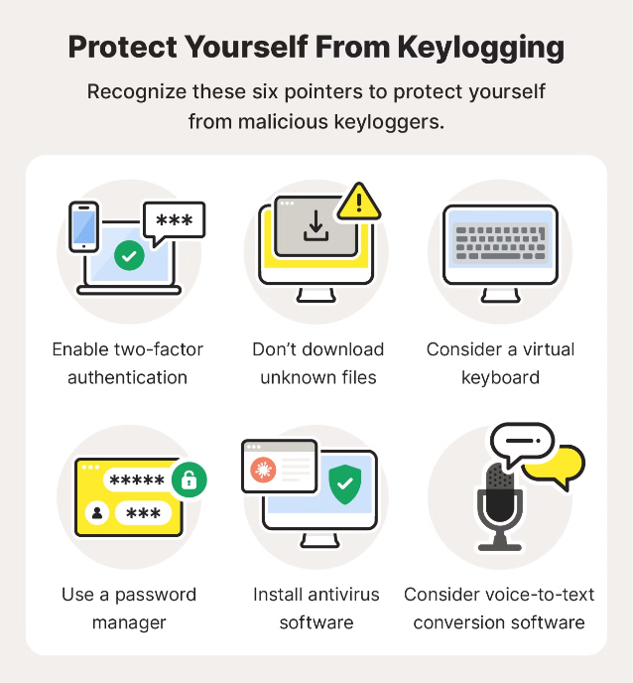
YOUR SOLUTION AND ITS VALUE PROPOSITION
Value Proposition
Enhanced Security: Reduces the risk of data breaches and identity theft.
User Awareness: Educates users about key logging threats and protection methods.
Compliance: Helps businesses and organizations comply with data protection regulations.
Notes:
<number>

Slide 8

The Wow in Your Solution
Innovative Approach: Combining technical measures with user education for comprehensive protection.
Demonstration: Real-time demonstration of a simple keylogger to illustrate the threat and the effectiveness of security measures.
Impact: Significant reduction in the likelihood of keylogging attacks through proactive measures.
Notes:
<number>

Slide 9
Modelling
Architecture Overview
Modular Design: The keylogger code is structured into modular functions for better readability and maintenance.
Event Handling: Utilizes the pynput library to capture and handle keyboard events.
Data Logging: Implements functions to log captured data into text and JSON files.
Components
Key Press Handling:
Function: on_press(key)
Description: Captures and logs the pressed keys.
Details: Appends key press events to a list and updates the JSON log file.
Key Release Handling:
Function: on_release(key)
Description: Captures and logs the released keys.
Details: Appends key release events to a list, updates the JSON log file, and accumulates keys for the text log.
Logging Functions:
Text Logging: generate_text_log(key)
Description: Writes the recorded keys to key_log.txt.
JSON Logging: generate_json_file(keys_used)
Description: Dumps the list of key events to key_log.json.
Notes:
<number>

Slide 10
Modelling
GUI Integration
Tkinter Framework: Utilizes tkinter for creating a graphical user interface.
User Interaction:
Start Button: Initiates the keylogger.
Stop Button: Stops the keylogger.
Status Updates: Provides real-time feedback on the status of the keylogger (running/stopped).
Flow Diagram
Initialization: Set up the main GUI window. Initialize global variables for key logging.
Event Capture: Start capturing key events when the "Start" button is pressed. Log key press and release events.
Data Logging: Continuously update text and JSON log files with captured key events.
Stop Logging: Stop capturing key events when the "Stop" button is pressed. Update the GUI status to indicate the keylogger is stopped.
Notes:
<number>

Slide 11
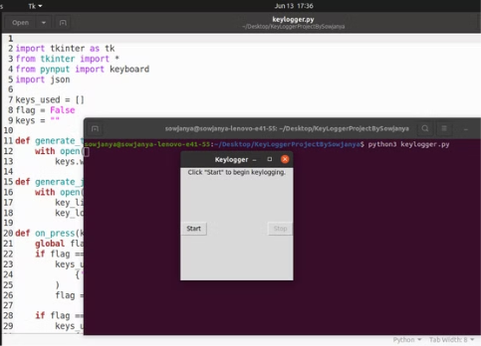
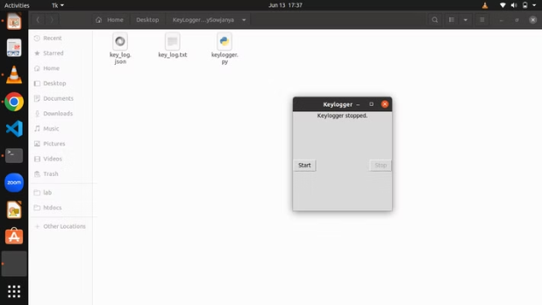
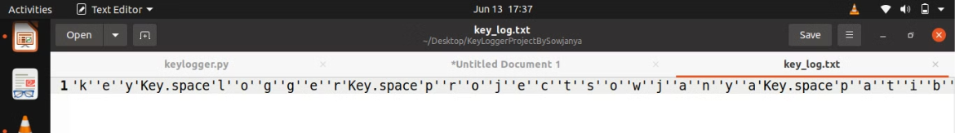
Results
Screenshots of the GUI: Displays the user interface, including the start and stop buttons, and the status label.
Sample Logs: Show examples of the key_log.txt and key_log.json files to illustrate how the keystrokes are recorded.
Notes:
<number>

Slide 12

Conclusion
Successfully implemented a keylogger that captures keystrokes and records them into both text and JSON files. Real-time keylogging with start and stop functionality controlled via a simple GUI.
The keylogger project demonstrated the capability to effectively capture and log keystrokes in real-time.
The GUI provided a user-friendly way to control the keylogger, making it accessible and easy to use.
Emphasized the ethical use of keyloggers and the importance of implementing security measures to protect against malicious use.
Notes:
<number>

